Slide 1
Eiropas aizsardzības industrijas programmas (EDIP) iespējas
INFORMATĪVAIS SEMINĀRS
sadarbībā ar Latvijas pārstāvniecību ES
un Latvijas Investīciju un attīstības aģentūru
2026. gada 20. maijā

Slide 2
Programma
11:00 – 11:10 Ievadvārdi
11:10 – 11:30 Īss pārskats no Latvijas delegācijas
11:30 – 12:15 Eiropas Komisijas Aizsardzības industrijas un kosmosa ģenerāldirektorāta (DEFIS) eksperta prezentācija
ANGĻU VALODĀ
12:15 – 12:30 Jautājumi un atbildes
Noslēgums
Notes:
Elīna

Slide 3
Par semināra norisi
Ieraksts un prezentācijas būs pieejams AM mājaslapā sadaļā «Uzņēmējiem»
Jautājumi jāuzdod rakstiski Q&A sadaļā
Jautājumus iespējams uzdot gan latviešu, gan angļu valodā
Ja jautājumu nevarēs paspēt / nebūs iespējams atbildēt vebināra laikā, apkoposim un rakstiskas atbildes nopublicēsim AM mājaslapā
Notes:
Elīna

Slide 4
Programma
11:00 – 11:10 Ievadvārdi
11:10 – 11:30 Īss pārskats no Latvijas delegācijas
11:30 – 12:15 Eiropas Komisijas Aizsardzības industrijas un kosmosa ģenerāldirektorāta (DEFIS) eksperta prezentācija
ANGĻU VALODĀ
12:15 – 12:30 Jautājumi un atbildes
Noslēgums
Notes:
Elīna

Slide 5
ES aizsardzības industrijas atbalsts un Defence Readiness 2030
Mārtiņš Paškēvičs

Slide 6
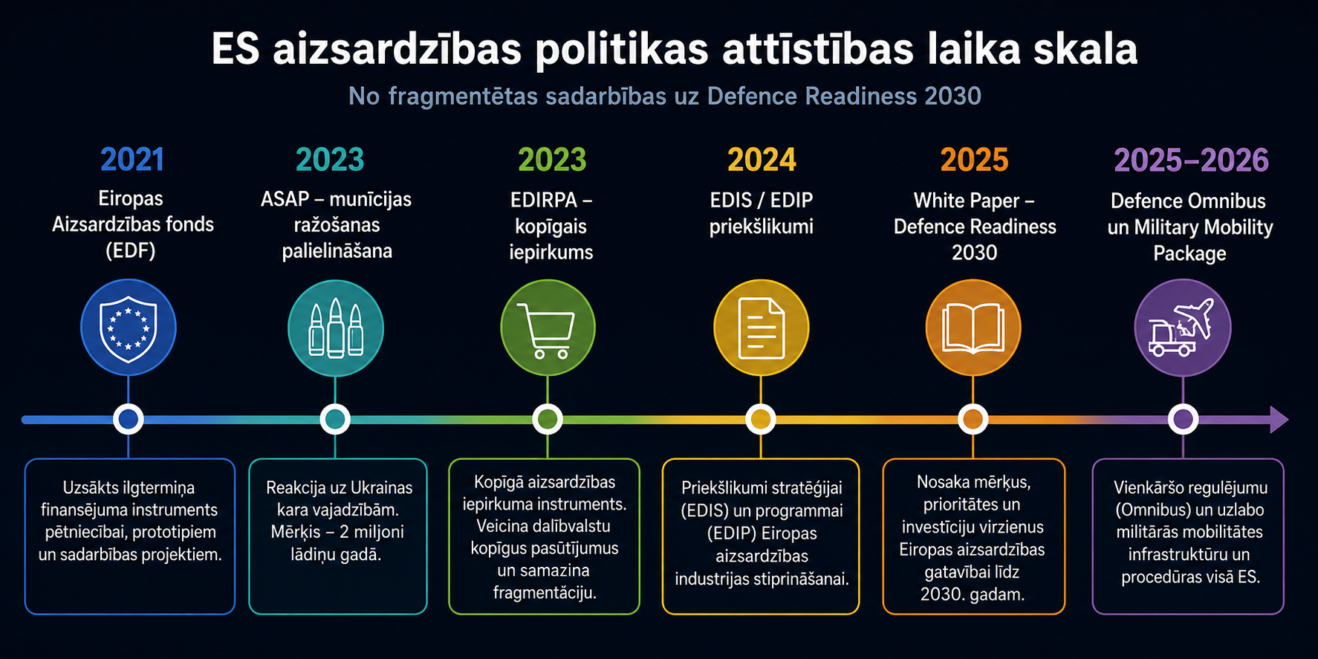
ES aizsardzības politikas evolūcija – pirms un pēc kara Ukrainā

Slide 7
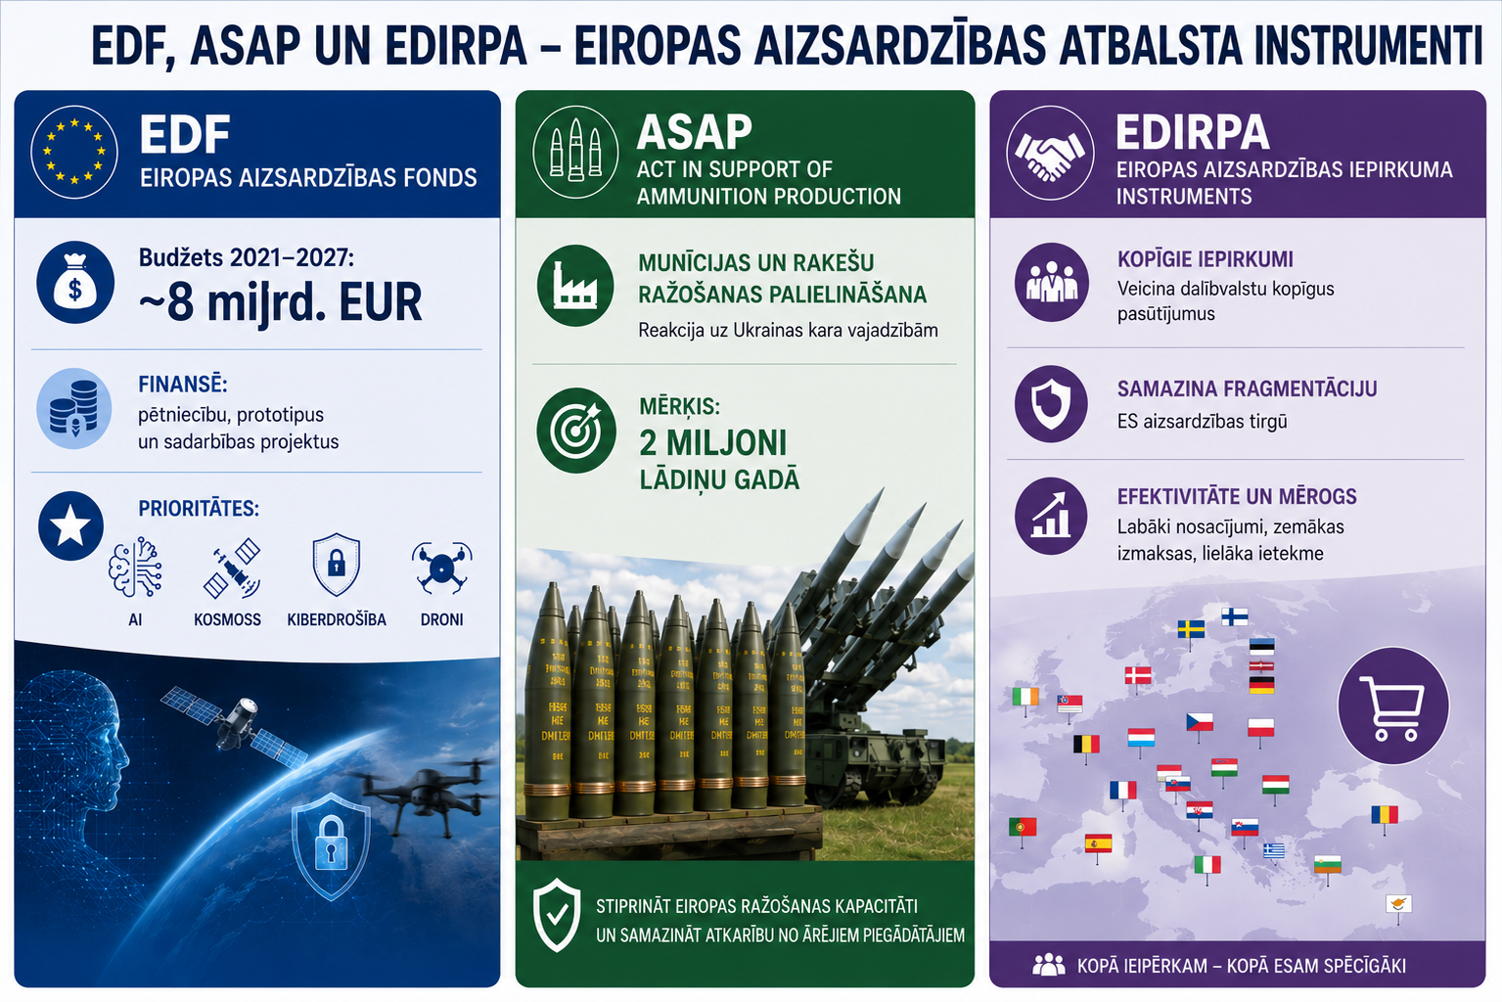
EU iepriekšējās atbalsta aktivitātes (līdz 2024.gadam)

Slide 8
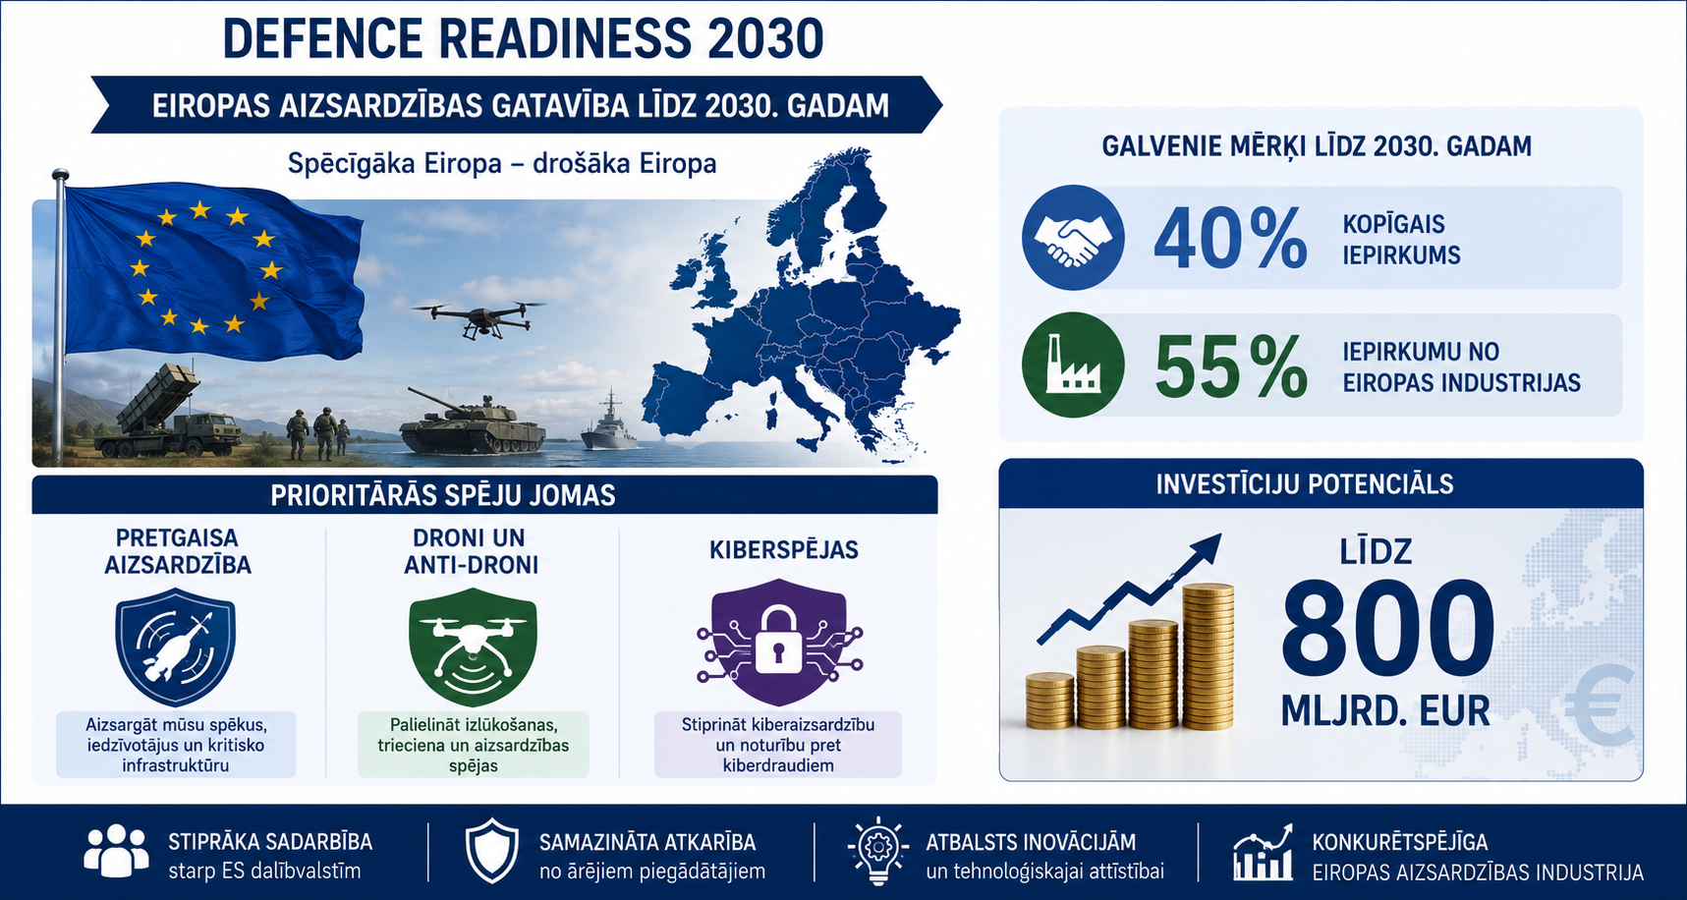
Defence Readiness 2030

Slide 9
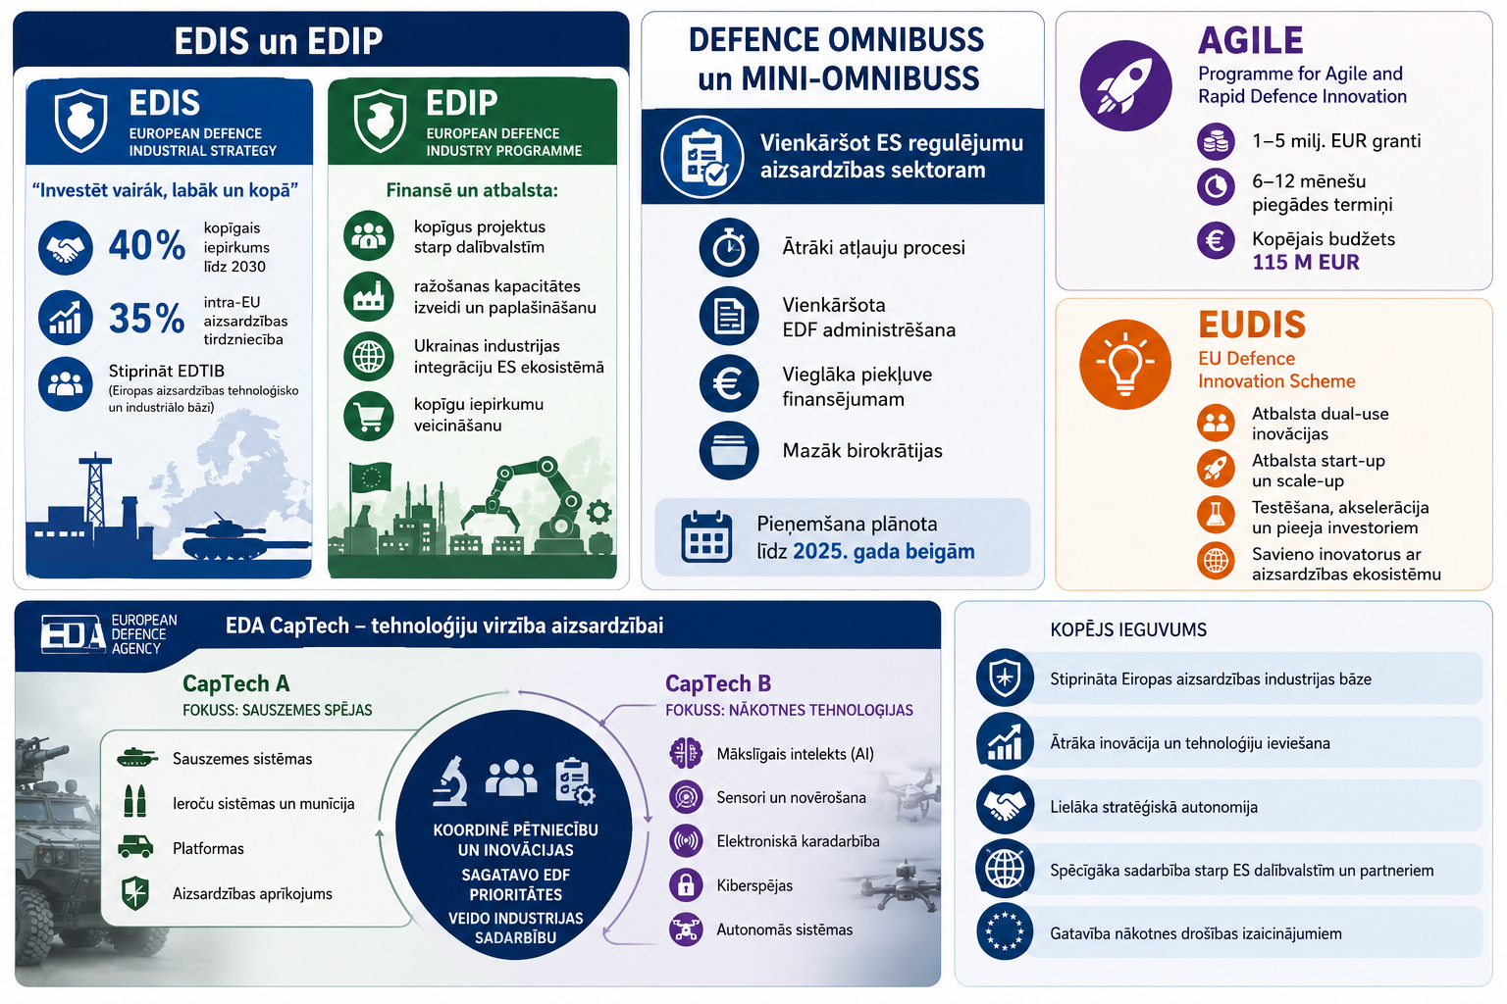
Kas tiek darīts lai ieviestu Defence Readiness 2030

Slide 10
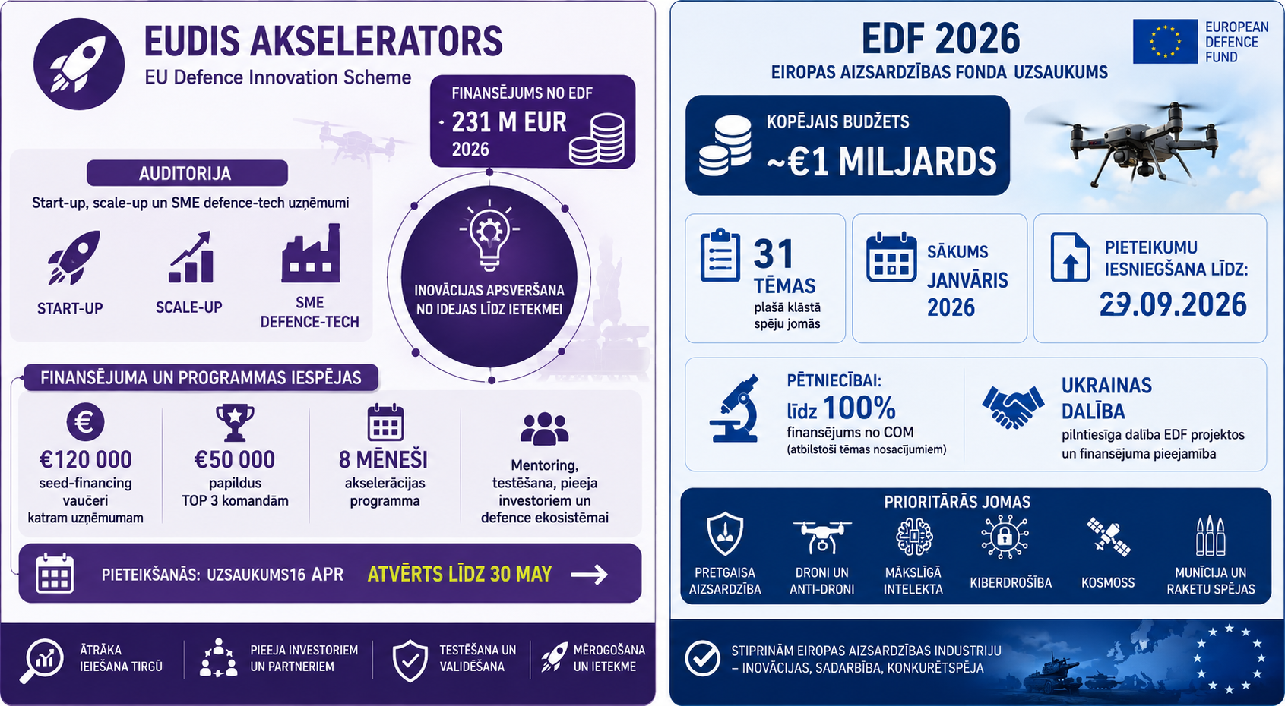
EDF un EUDIS 2026.gadā

Slide 11

Likumdošanas iniciatīvas 2026.gadā – MM un aizsardzības iepirkumu direktīva

Slide 12
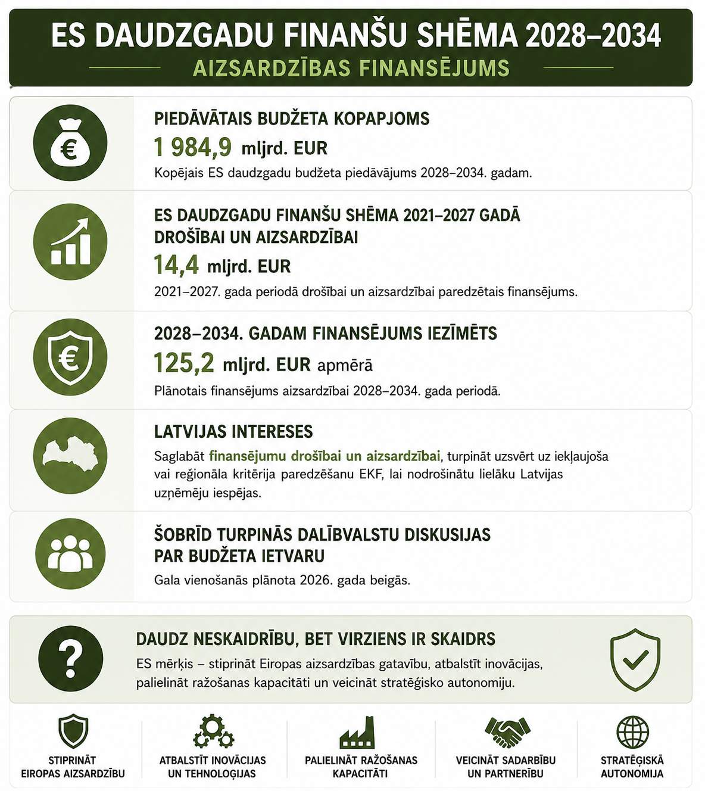
Kā dzīvosim pēc 2028.gada

Slide 13
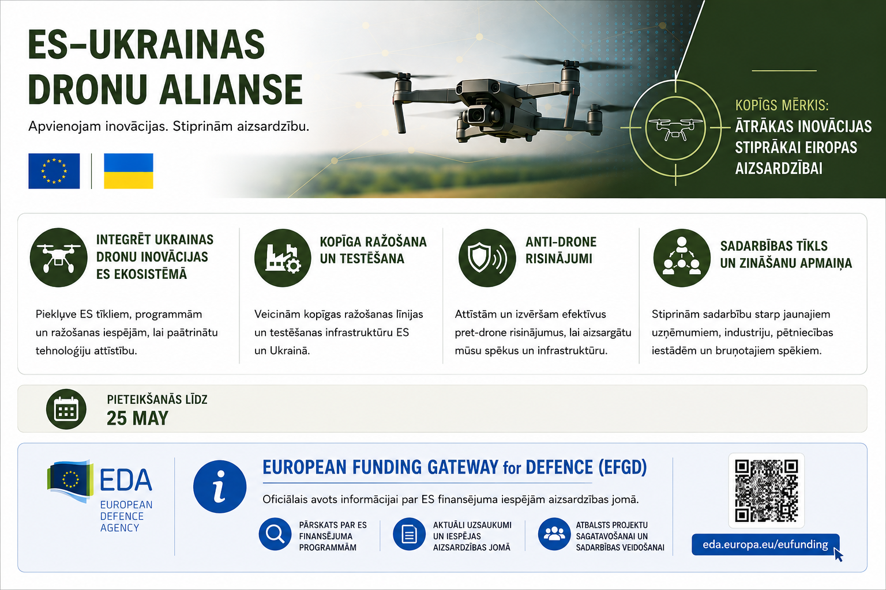
EU-UA dronu alianse/EDA portāls par ES finansējumu

Slide 14
Paldies par uzmanību!

Slide 15
Programma
11:00 – 11:10 Ievadvārdi
11:10 – 11:30 Īss pārskats no Latvijas delegācijas
11:30 – 12:15 Eiropas Komisijas Aizsardzības industrijas un kosmosa ģenerāldirektorāta (DEFIS) eksperta prezentācija
ANGĻU VALODĀ
12:15 – 12:30 Jautājumi un atbildes
Noslēgums
Notes:
Elīna

Slide 16
European Defence Industry Programme
LV national EDIP Info day
20 May 2026
Guillaume GALTIER
Team leader EDIP programming
DEFIS.B.1

Slide 17
Evolution of EU Defence Industry Programmes
Target/Year | 2017-2020 | 2021 | 2022 | 2023 | 2024 | 2025 | 2026 | 2027 | 2028-2034
Research & Development
Industrial Reinforcement
Common Procurement
More
AGILE
European
Competitiveness
Fund
PADR
European Defence Fund
EDIDP
European Defence Industry Programme
ASAP
EDIRPA
17

Slide 18
Foreword
Important!
EDIP broad ➔ Not possible to cover everything in detail
The following presentation is for information
Additional information available on our dedicated EDIP webpage
Legally binding information to be found in the respective call documents (available soon) on the EU Funding & Tenders Portal

Slide 19
Content
EDIP work programme content
Focus on IRA calls and conditions, including USI IRA ones
Information on CPA calls
Information on EDPCIs
Information on FAST
Information on other supporting actions
19

Slide 20
Content
EDIP work programme content
Focus on IRA calls and conditions, including USI IRA ones
Information on CPA calls
Information on EDPCIs
Information on FAST
Information on other supporting actions
20

Slide 21


Overview of EDIP work programme
EDIP
€1,5 billion
The Programme (EU + NO)
€1,2 billion
Ukraine Support Instrument (USI) (EU+UA)
€300 million
Industrial reinforcement actions
Common procurement actions
Supporting actions
European Defence projects of common interest (EDPCIs)
Fund to accelerate defence supply chains’ transformation (FAST)
Industrial reinforcement actions
Supporting actions
Eg: EDIP-USI-2026-LS-IRA
Eg: EDIP-P-2026-LS-IRA
21

Slide 22







Overview of EDIP funding opportunities
Industrial Reinforcement Actions (IRA)
Common Procurement Actions (CPA)
Other
Energetic components
€166.4 M
Counter-drone systems
€30 M
EDPCI deployment + coordination & support action
€325 M
Key electronic components
€122.25 M
Ammunition, missiles and other explosive weapons
€60 M
SEAP
Support to SEAP functioning
€10 M
Platforms and end products
€152.75 M
Air and missile defence systems
€60 M
Joint ammunition qualification (JAQ)
€50 M
Ground and naval platforms and systems
Missiles ammunition and bombs
€184.5 M*
€60 M
Defence innovation action
€36.3 M*
Ukraine Support Instrument (USI)
Ukraine Support Instrument (USI)
Funds accelerating supply chain transformation (FAST)
SME-support, Defence talent platform, Military Sales Catalogue…
Unmanned systems and counter-unmanned systems
€82 M*
C5ISR and other space-related products
€30 M
€100 M
Ukraine Support Instrument (USI)
€5.8 M
22
* Including €7,5M of external assigned revenues

Slide 23
Content
EDIP work programme content
Focus on IRA calls and conditions, including USI IRA ones
Information on CPA calls
Information on EDPCIs
Information on FAST
Information on other supporting actions
23

Slide 24
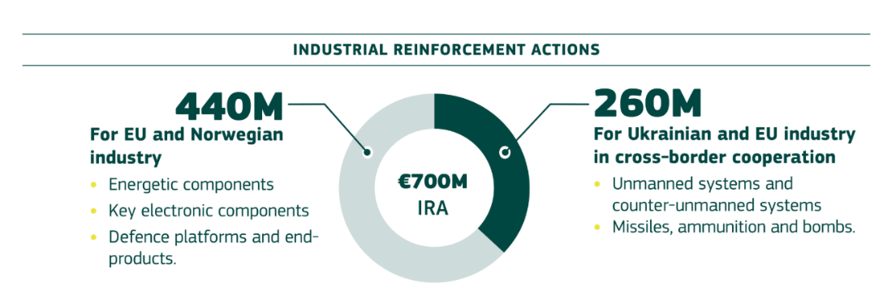





Industrial reinforcement actions (incl. USI)
Objective: reinforcing defence industrial production capacity (increasing competitiveness of EDTIB, strengthening availability and security of supply and reducing lead-times)
*
IRA
USI
IRA
* to which €6,5M of external assigned revenues will be added
24

Slide 25
Industrial reinforcement – Eligible activities
Activities related to accelerating the adjustment to structural changes of the capacity of the defence products, including their components and corresponding raw materials insofar as they are intended or used wholly for the production of defence product, in particular:
the optimisation, [...] of [...] of production capacity of defence products;
the establishment of cross-border industrial partnerships [...] in a joint industrial effort, [...];
the building-up and making available of reserved surge manufacturing capacities of defence products, [...];
fostering the industrialisation and commercialisation of defence products developed in the framework of actions funded by the EU [...];
the testing [...] of defence products with a view to addressing their obsolescence and making them useable by end-users.
[optional] – procurement of physical and cyber protection systems
25

Slide 26
Industrial reinforcement – Overview IRA
EDIP-IRA:
Energetic Components (EUR 166.4 million)
Deadline to apply: 16 June 2026
EU funds 35-50% of project
Maximum EUR 30 million per project
Key Electronic Components (EUR 122.25 million)
Deadline to apply: 16 February 2027
EU funds 35-50% of project
Maximum EUR 20 million per project
Defence Platforms and End-products (EUR 152.75 million)
Deadline to apply: 16 February 2027
EU funds 35-50% of project
Maximum EUR 30 million per project
Industrial Reinforcement Actions (IRA)
Energetic components
€166.4 M
Key electronic components
€122.25 M
Platforms and end products
€152.75 M
Missiles ammunition and bombs
€184.5 M*
Ukraine Support Instrument (USI)
Unmanned systems and counter-unmanned systems
€82 M*
Ukraine Support Instrument (USI)
26
* Including €6,5M of external assigned revenues

Slide 27
Industrial reinforcement – Zoom-in: IRA
Energetic Components:
Proposals must address at least one listed production capacity contributing to at least one listed product
Production capacities: | Products:
Propellant powder Explosives Propulsion Systems Warheads and electronic fuses Filling Plants Access to relevant raw materials | rockets, aerial bombs, mines and loitering munition missiles tank, artillery and counter-unmanned systems (UxS) ammunition small-calibre cartridges
27

Slide 28
Industrial reinforcement – Zoom-in: IRA
Key Electronic Components:
Proposals must address at least one listed production capacity contributing to at least one listed product
Production capacities: | Products:
Guidance Electronics Propulsion Electronics RF and Laser Modules Multispectral Cameras Avionics PCBs and IC Substrates Lithium-ion Polymer Batteries Power Electronics Critical Semiconductor Building Blocks | (swarming) UxSs and loitering munitions (counter-)UxS systems missile (defence) systems precision-guided munitions mobile communication nodes and C2 systems C4ISR
28

Slide 29
Industrial reinforcement – Zoom-in: IRA
Platforms and End-products:
Proposals must address at least one listed production capacity contributing to at least one listed product
Production capacities: | Products:
Forging/Machining Key Sub-systems Composites Materials Assembly/Integration of End Products Manufacturing as a Service Dual-Use (Heavy) Industry Conversion Options for Defence Surge | artillery systems armoured vehicles fixed and rotary wing aircraft (counter-)UxS systems (anti-)PGM systems radars mine warfare systems naval platforms firearms satellite payloads & terminals
29

Slide 30
Industrial reinforcement – Overview USI-IRA
USI-IRA:
Missiles, ammunition and bombs (EUR 184.5 million*)
Deadline to apply: 13 October 2026
EU funds up to 100% of eligible project costs
Maximum EUR 30 million per project
Unmanned systems and counter-unmanned systems (EUR 82 million*)
Deadline to apply: 16 February 2027
EU funds up to 100% of eligible project costs
Maximum EUR 10 million per project
Industrial Reinforcement Actions (IRA)
Energetic components
€166.4 M
Key electronic components
€122.25 M
Platforms and end products
€152.75 M
Missiles ammunition and bombs
€184.5 M*
Ukraine Support Instrument (USI)
Unmanned systems and counter-unmanned systems
€82 M*
Ukraine Support Instrument (USI)
30
* Including €6,5M of external assigned revenues

Slide 31
Industrial reinforcement – Zoom-in: IRA-USI
Missiles, Ammunition, and Bombs:
Proposals must address at least one listed production capacity contributing to at least one listed product
Production capacities: | Products (incl. subcomponents):
joint filling plants and production lines reinforcement of specific production capacity and enablement capacity scale-up of UA systems and ready-to-use production lines Manufacturing as a Service dual-use heavy industry conversion options for defence surge | air defence missiles and ammunition (including counter-UxS systems) deep strike capabilities (including long-range missiles) rockets, (smart) bombs and loitering munitions.
31

Slide 32
Industrial reinforcement – Zoom-in: IRA-USI
Unmanned Systems and Counter-Unmanned Systems:
Proposals must address at least one listed production capacity contributing to at least one listed product
Production capacities: | Products (incl. subcomponents):
joint production lines reinforcement of specific production capacity and enablement capacity scale-up of UA systems and ready-to-use production lines Manufacturing as a Service dual-use heavy industry conversion options for defence surge | UxSs and UxS interceptor variants EW-resilient UxS variants and counter-UxSs EW(-resilient) Supporting Systems
32

Slide 33
Industrial reinforcement – Overview of calls
Calls: 4 | Topics: 5 | Submission deadline | Funding allocation (incl. €200k-500k for opt. WP)
EDF-EDIP-P-2026-LS-IRA | EDF-EDIP-P-2026-LS-IRA-EC (Energetic Components) | 16 Jun 2026 | Total of €166,40 million Max €30 million / project
EDF-EDIP-P-2027-LS-IRA | EDF-EDIP-P-2027-LS-IRA-KEC (Key Electronic Components) | 16 Feb 2027 | Total of €122,25 million Max €20 million / project
 | EDF-EDIP-P-2027-LS-IRA-PE (Platforms and End-products) | 16 Feb 2027 | Total of €152,75 million Max €30 million / project
EDF-EDIP-USI-2026-LS-IRA | EDF-EDIP-USI-2026-LS-IRA-MAB (Missiles, Ammunition & Bombs) | 13 Oct 2026 | Total of €184.5 million* Max €30 million / project
EDF-EDIP-USI-2027-LS-IRA | EDF-EDIP-USI-2027-LS-IRA-CUXS (Unmanned Systems and Counter-Unmanned Systems) | 16 Feb 2027 | Total of €82 million* Max €10 million / project
33
* Including €6,5M of external assigned revenues

Slide 34
Industrial reinforcement – Payment scheme
Funding rates: IRA 35%, IRA-USI 100% of eligible project costs
IRA-Bonus (only for SEAP or when majority of beneficiaries are SMEs/mid-caps):
+7.5% for new cross border cooperation
+7.5% for building new infrastructure; or new or ramped-up manufacturing capacities of crisis-relevant products
Lump Sum Grants: Upfront assessment of detailed eligible costs estimates
Initial Pre-Financing of up to 35% of grant amount
Interim payments made at end of negotiated reporting periods (usually 12-18 months) upon approval of a periodic report based on completed work packages
Pre-financing and interim payments max. 90% of grant amount
Final payment reimburses the remaining eligible lump sum contributions claimed for the implemented work packages (min. 10%)
34

Slide 35
Industrial reinforcement – Award criteria
IRA Criteria | USI-IRA Criteria | Weight
1- Objectives 1.1 Alignment with objective, scope and priorities of the call topic 1.2 Contribution to competitiveness 1.3 Resilience and geographical distribution | 1- Objectives 1.1 Alignment with objectives pursued by USI 1.2 Integration to the EDTIB and the Union | 2
2- Availability and security of supply in response to identified risks 2.1 Availability and security of supply related to identified risks | 2- Timely availability and supply of defence products in UA 2.1 Timely availability and supply of defence products in UA | 2
3- Cross-border cooperation, inclusion of SMEs and mid-caps, or the link with orders stemming from common procurement 3.1 Development of cross-border cooperation, from demand or industrial side | 3- Cross-border cooperation between UA and EU 3.1 Cross border cooperation between UA and EU | 2
4- Expected results 4.1 Compliance with expected results set out in the call topic | 4- Expected results 4.1 Compliance with expected results set out in the call topic | 1
5- Production lead time, increase in production capacity, reserved capacity and workforce skilled 5.1 Reduction of the production lead time, increase in production capacity, reserved capacity and workforce skilled | 5- Production lead time and increase in production capacity in UA 5.1 Reduction of the production lead time, increase in production capacity in UA | 2
6- Quality & efficiency of implementation 6.1 Work-plan and work-packages 6.2 Project design and quality of management | 6- Quality & efficiency of implementation 6.1 Work-plan, and work-packages 6.2 Project design and quality of management | 3
35

Slide 36
Industrial reinforcement - Eligibility
Who can apply:
IRA
Legal entities
Need to be located in EU or Norway
Not controlled by non-EU/NO third country or entity (derogation possible)
Consortium not required (max. 15 entities) [Exception: art 12.1.d activity – previous consortium project with EU funding]
IRA-USI
Legal entities
Need to be located in EU or (government-controlled areas of) Ukraine
Not controlled by non-EU/UA third country or entity (derogation only for EU entities possible)
Consortium not required (max. 15 entities) [Exception: art 12.1.d activity – previous consortium project with EU funding]
UA entity must be involved
Please read the call documents for the legally binding eligibility criteria!
36

Slide 37
Industrial reinforcement - Eligibility
Which projects can apply:
Actions complying with topic description and addressing at least one of IRA eligible activities
Component origin: Cost of components from outside the EU/Norway (UA for USI) must be not more than 35%
Design Authority: There must be design control and ability to replace restricted non-EU/Norwegian (UA for USI) components (Exception under IRA: Ammo & Missiles with extended deadline 31 December 2033)
Horizontal exclusions: Actions prohibited by international law, lethal autonomous systems that are contrary to international humanitarian law, cluster munitions and actions that are already fully financed
Retroactivity: Cost incurred after 5 March 2024 can be eligible if relevant and necessary to implement the action
Please read the call documents for the legally binding eligibility criteria!
37

Slide 38
Industrial reinforcement – Security aspects
Proposals content (Part B & Annexes) considered Sensitive non-classified (SNC) by default
Content to be submitted as a password-protected archive (AES-256 zip-encrypted archive)
Password to be sent to DEFIS-EDIP-PROPOSALS-PWD@ec.europa.eu
Handled by Commission as SNC on a need-to-know basis
If deemed necessary by your national security authorities, possibility to classify Part B sections corresponding to award criteria 2 and/or 5
Two Part B files to be provided as part of your application (by submission deadline):
a classified Part B with only sections corresponding to award criteria 2 and/or 5
an unclassified Part B with all other sections
Contact DEFIS-DEFENCE-SECURITY@ec.europa.eu upfront to arrange delivery of classified part

Slide 39
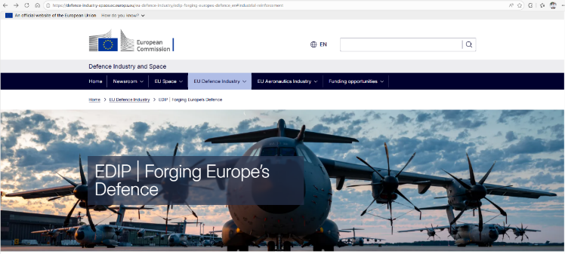
Industrial reinforcement – More information
To find out more:
Read the call documents on the EU Funding & Tenders Portal
Visit our website and watch our tutorial videos
Q&A webinar on 27 May - Register here by 25 May COB!
39

Slide 40
Content
EDIP work programme content
Focus on IRA calls and conditions, including USI IRA ones
Information on CPA calls
Information on EDPCIs
Information on FAST
Information on other supporting actions
40

Slide 41

Common Procurement
EUR 240 million to support common procurement
For EU Member States and Norway
To decrease fragmentation and increase interoperability
EUR 20 million per project
41

Slide 42
Common Procurement – Overview of calls
Calls: 2 | Topics: 5 | Submission deadline | Funding allocation
EDF-EDIP-P-2026-FNLC-CPA | EDF-EDIP-P-2026-FNLC-CPA-CDS (Counter-drone systems) | 13 Oct 2026 | Total of €30 million Max €20 million / project
 | EDF-EDIP-P-2026-FNLC-CPA-AMEW (Ammunition, missiles and other explosive weapons) | 13 Oct 2026 | Total of €60 million Max €20 million / project
EDIP-P-2027-FNLC-CPA | EDF-EDIP-P-2027-FNLC-CPA-AMDS (Air and missile defence systems) | 16 Feb 2027 | Total of €60 million Max €20 million / project
 | EDF-EDIP-P-2027-FNLC-CPA-GNPS (Ground and naval platforms and systems) | 16 Feb 2027 | Total of €60 million Max €20 million / project
 | EDF-EDIP-P-2027-FNLC-CPA-C5ISRS: (C5ISR and other space-related products) | 16 Feb 2027 | Total of €30 million Max €20 million / project
42

Slide 43
Content
EDIP work programme content
Focus on IRA calls and conditions, including USI IRA ones
Information on CPA calls
Information on EDPCIs
Information on FAST
Information on other supporting actions
43

Slide 44

European Defence Projects of Common Interest
EUR 325 million for new, ambitious, and collaborative European defence projects
To be established by the Council
Open to all EU Member States, Norway, and Ukraine
May be continued under the future EU Multiannual Financial Framework
44

Slide 45
European Defence Projects of Common Interest
A game changer for ambitious collaborative defence industrial projects
STEP1 Identification of EDPCIs
STEP 2 Funding of EDPCI
Long-term collaborative industrial projects with EU-wide benefits
Contributing to development of MS critical military capabilities​
High political visibility and endorsement
EUR 300 million to start implementation
€ 325 million
for EU/NO national authorities
EUR 25 million to prepare next phases
Additional financing expected under next MFF
Council implementing act(s)
Common procurement
Industrial ramp-up
Development
Infrastructure
45

Slide 46
Content
EDIP work programme content
Focus on IRA calls and conditions, including USI IRA ones
Information on CPA calls
Information on EDPCIs
Information on FAST
Information on other supporting actions
46

Slide 47
Fund Accelerating Defence Supply Chains Transformation
Improve access to equity finance for European defence companies
Contribution to a pan-European fund-of-funds
(Defence Equity Facility 2.0)
Target: EUR 1 billion
Private funds
Companies
Venture capital
SMEs &
small midcaps
Timeline: Opening of call for Expression of interest for fund managers in Q2/Q3 2026
Private equity
FAST
€ 100 million
Private debt
European Investment Bank group
Infrastructure
In EU or Norway
Industrialising / manufacturing of defence products, or
In EU defence supply chain
In line with MS capability priorities
Member States
In EU or Norway
Focused on defence
Providing growth financing
High leverage effect reached through the fund-of-funds
47

Slide 48
Content
EDIP work programme content
Focus on IRA calls and conditions, including USI IRA ones
Information on CPA calls
Information on EDPCIs
Information on FAST
Information on other supporting actions
48

Slide 49
USI Defence innovation action
DG DEFIS
Total amount of the action: € 36.3 million*
Focus on EU and Ukrainian SMEs, including startups and mid-caps (single or consortium)
Boost innovation to address Ukraine’s immediate frontline needs
Strengthen the European defence industry’s innovation capacity
Under BraveTechEU brand
Small grants (max €200 OOO)
Entry-TRL 4+
60% of funded solutions must reach TRL 7+
More information to come
€36,3M*
UA implementation partner
Publishes calls for EU & UA SMEs
Air defence systems Drones in all domains (air, ground, naval) Missiles & ammunition Electronic warfare / signal intelligence AI and machine learning Navigation and communication systems Future technologies (lasers, exoskeletons etc.) Software developments
Max €200k
UA SME or EU SME or UA+EU SMEs
49
* Including €1M of external assigned revenues

Slide 50

USI innovation action under
One brand for all innovation actions of the EU with Ukraine
3 pillars, out of which 2 pillars are EU-funded:
1
Ukraine-funded pillar
2
EDF pillar (€50 million)
EDIP-USI pillar (€35,3 million)
Phase 1: DefTechForges
€120k prizes and mentoring programme for winners only
Week-long events
Currently for EU applicants (+UA if they join a consortium)
Entry TRL 4+
Phase 2: Testing campaigns with EDA
€500k prizes for winners
Weeks- or months-long campaigns
Only open for Phase 1 winners
Grants programme
Variable grants sizes
For UA entities only
USI Defence Innovation Action
Max €200k grants
Months-long projects
For UA and EU SMEs (also single)
Testing in Ukraine possible
Entry TRL 4+
EU-funded
Ukraine-funded
50

Slide 51
Joint Ammunition Qualification
No European system for ammunition qualification
Low interoperability
Duplication of tests
High cost for industry
JAQ: Pilot project to harmonise national procedures for 155mm ammunition
Implemented by EDA, open to all EU Member States & Norway, Budget: EUR 50 M
Laying the foundations for a European Ammunition Qualification System
51

Slide 52

Structure for European Armament Programme
Legal body established by the Commission upon MS request and application
For Member States and Associated Countries
To manage international armament programmes
Might be exempted from VAT
Eligible to apply for EDIP (and future ECF) calls
EUR 10 million to support functioning of SEAP (max EUR 2 million per SEAP)
52

Slide 53
Defence Talent Platform
Encouraging young graduates and professionals to pursue a career in defence.
Providing a comprehensive overview of entry-level jobs and traineeships across the defence sector in the EU.
Providing vouchers for traineeships in defence SMEs and small mid-caps, including start-ups and scale-ups, of up to EUR 2,000 per voucher.
Between 200-500 traineeships to be supported.
Platform foreseen to launch in Q4 2026.
53

Slide 54
Military Sales Catalogue
Single, centralised and up-to-date online catalogue of European and Ukrainian defence products
It will indicate if the manufacturer has the design authority of its product and may indicate if it has received support through EU defence instruments.
It will also showcase European Defence Fund-backed defence technologies and products.
Member States, Norway, Ukraine and economic operators will be invited to populate the catalogue on a voluntary basis.
More information to follow
54

Slide 55
Security of Supply
The Security of Supply regime in the EDIP Regulation provides the Union with a structured framework for mapping, monitoring, and responding to security-related supply crises.
The Security of Supply Board will advise and support the Commission
Commission will
map supply chains to identify crisis-relevant products and early-warning indicators
regularly monitor manufacturing capacities for crisis-relevant products
conduct stress tests, including simulations, to anticipate supply crises
if appropriate, propose to the Council to activate a supply-crisis or security related supply crisis state
Member States will identify a list of key market actors
manufacturing capacity and supply chains of defence products
suppliers of crises relevant products and their production capacity
55

Slide 56
Useful Links
EDIP Webpage (for general information and tutorials)
EU Funding & Tenders Portal (where to find call documentation and apply to funding)
EDIP Regulation
EDIP Work Programme
For remaining questions: DEFIS-EDIP-PROPOSALS@ec.europa.eu
56

Slide 57
Many thanks for your attention!
Questions?
57

Slide 58
Par tuvākajiem pasākumiem
Eiropas Komisijas vebinārs par EDIP 27. maijā
→ Reģistrācija līdz piektdienai 25. maijam
Info diena par Eiropas Aizsardzības fondu (EDF)
Jūnija pirmajā pusē (info drīzumā!)
Aizsardzības ministrijā (klātienē)
Informatīvais vebinārs par NATO STO (Science and Tehnology Organisation)
Jūnijā (info drīzumā!)
Vebināra formātā

Slide 59
Par vebināriem
Jautājumus un priekšlikumus vebināra tēmām aicinām iesūtīt uz industrija@mod.gov.lv vai defence@liaa.gov.lv
Iepriekšējie vebināra ieraksti pieejami AM mājaslapas sadaļā «Uzņēmējiem», kā arī liaa.business.gov.lv sadaļā «Noderīgi»

Slide 60


Slide 61

Aizsardzības nozares uzņēmumu kartēšana
https://business.gov.lv/aizsardzibas-industrijas-uznemumu-kartesana

Slide 62
Eiropas aizsardzības industrijas programmas (EDIP) iespējas
INFORMATĪVAIS SEMINĀRS
sadarbībā ar Latvijas pārstāvniecību ES
un Latvijas Investīciju un attīstības aģentūru
2026. gada 20. maijā

